Slide 1
PHOTO ALBUM
-BY SIRI

Slide 2


Slide 3
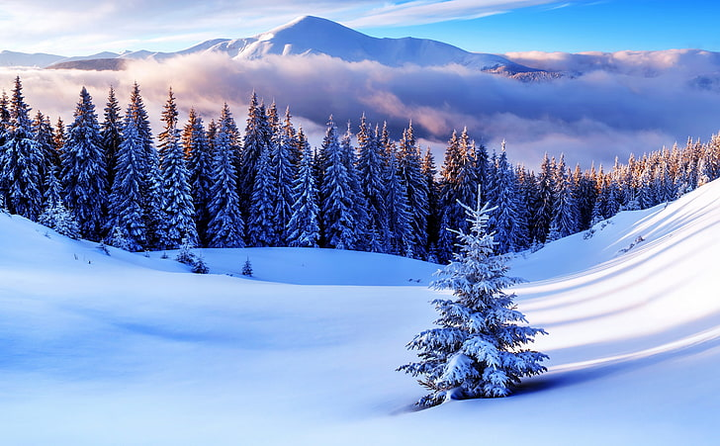

Slide 4
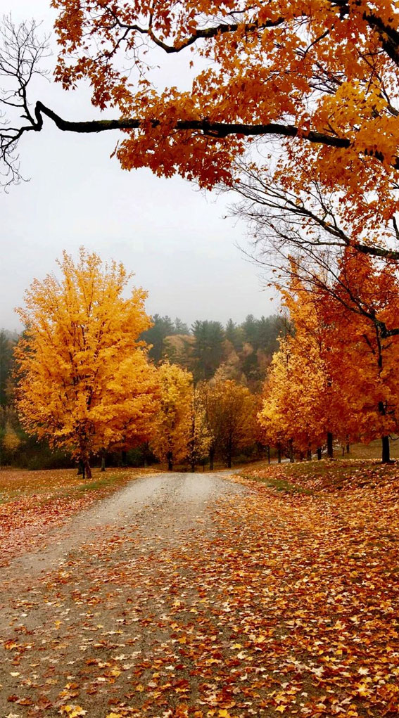

Slide 5


